Slide 1
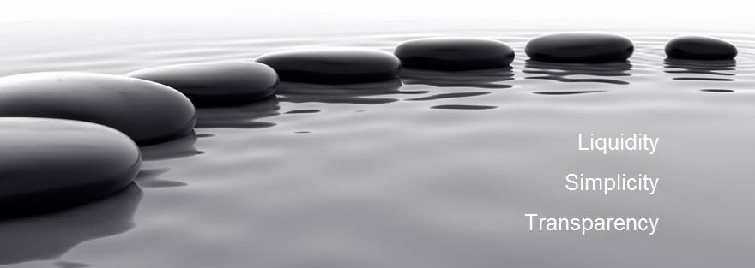

Medusa FX Option Trading Platform
Quick User Guide
Copyright Digital Vega FX Limited. All rights reserved
Dec 2014 v 3.0

Slide 2
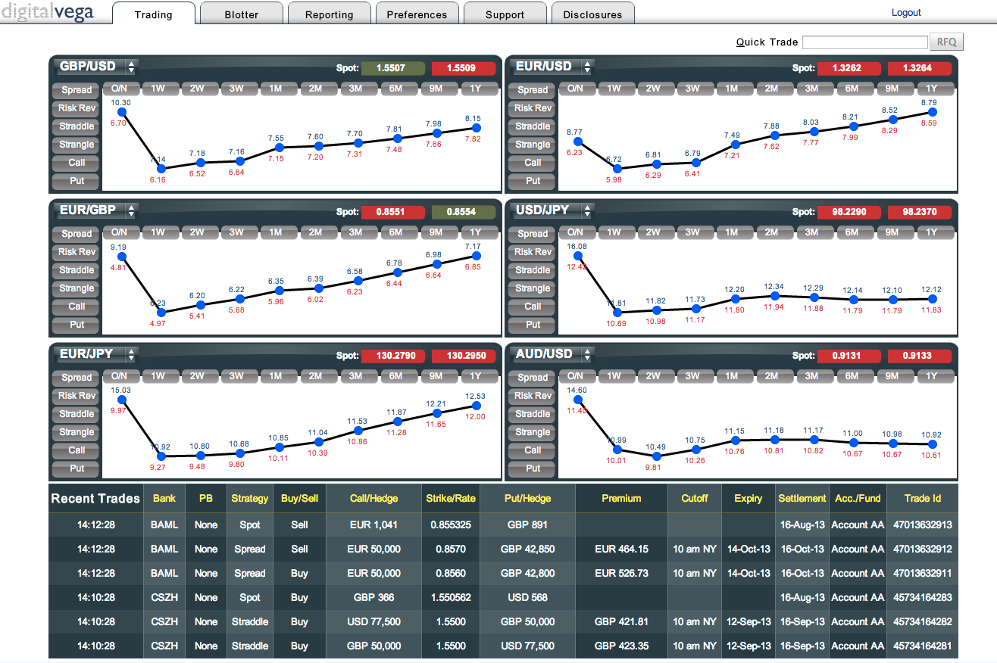
Desktop
Click tabs to navigate around system.
Click down arrow to change currency pair.
View volatility curves for standard maturities up to 1 Year.
Recently completed trades and active RFQ’s appear at bottom of screen.
Browser Compatibility:
Microsoft IE 8, 9, 10 and 11
Firefox 3+
Chrome
2

Slide 3
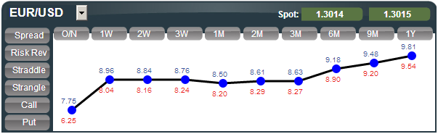
Chart panel – Pre-select standard tenor
1
To create an RFQ with pre-selected Expiry Date, click on a tenor button.
Underlying Spot rate created from a mix of Provider Bank indicative rates.
2
Click selected trade strategy.
Supported Currency Pairs
AUD/CAD | CAD/CHF | EUR/AUD | GBP/AUD | NOK/SEK | USD/CAD
AUD/CHF | CHF/JPY | EUR/CAD | GBP/CHF | NZD/JPY | USD/CHF
AUD/JPY |  | EUR/CHF | GBP/JPY | NZD/USD | USD/CZK
AUD/NZD |  | EUR/CZK | GBP/USD |  | USD/HUF
AUD/USD |  | EUR/GBP |  |  | USD/JPY
 |  | EUR/HUF |  |  | USD/MXN
 |  | EUR/JPY |  |  | USD/NOK
 |  | EUR/MXN |  |  | USD/PLN
 |  | EUR/NOK |  |  | USD/SEK
 |  | EUR/PLN |  |  | USD/TRY
 |  | EUR/SEK |  |  | USD/ZAR
 |  | EUR/TRY
 |  | EUR/USD
Chart displays aggregated indicative ATM Bid/Offer implied volatility for each currency pair.
3

Slide 4
Chart panel – Non-standard tenor
1
Click to create an RFQ with selected trade strategy; user can select non-standard tenor on trading panel.
Chart displays aggregated indicative ATM Bid/Offer implied volatility for each currency pair.
Supported Currency Pairs
AUD/CAD | CAD/CHF | EUR/AUD | GBP/AUD | NOK/SEK | USD/CAD
AUD/CHF | CHF/JPY | EUR/CAD | GBP/CHF | NZD/JPY | USD/CHF
AUD/JPY |  | EUR/CHF | GBP/JPY | NZD/USD | USD/CZK
AUD/NZD |  | EUR/CZK | GBP/USD |  | USD/HUF
AUD/USD |  | EUR/GBP |  |  | USD/JPY
 |  | EUR/HUF |  |  | USD/MXN
 |  | EUR/JPY |  |  | USD/NOK
 |  | EUR/MXN |  |  | USD/PLN
 |  | EUR/NOK |  |  | USD/SEK
 |  | EUR/PLN |  |  | USD/TRY
 |  | EUR/SEK |  |  | USD/ZAR
 |  | EUR/TRY
 |  | EUR/USD
4

Slide 5
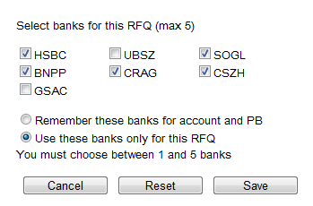
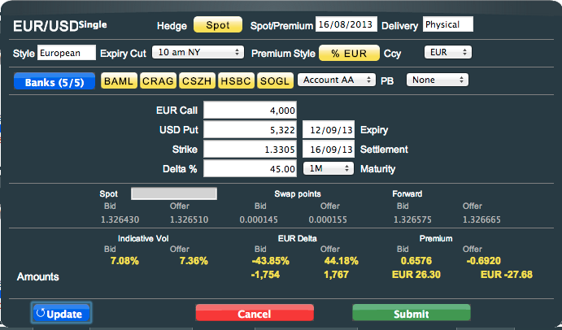
RFQ panel – Indicative pricing
Indicates how the currency pair will be delivery – physical or cash settled
Click to select Hedge type:
None = No Hedge
Spot = Spot Delta
Forward = Forward Delta
Spot date for currency pair.
Choose the Cut Time at expiry
Select Premium calculation basis:
- % Base currency
- % Term currency
- Pips Base currency
- Pips Term currency
Click to change Bank selection from defaults for currency pair (max 5 banks).
Select Prime Broker if relevant.
Pre-defined rate, relating to the Hedge type selection.
Indicative underlying Spot, Swap Points and Outright rates calculated for information only.
Re-calculates the indicative prices (and the strike where applicable)
Indicative Volatility, Delta and Premium displayed.
Delta display related to Hedge type selection.
5

Slide 6
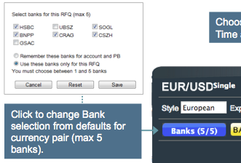
RFQ panel – Bank selection
Bank Liquidity Providers are selected using the blue “Banks” button on the RFQ pane. On initial log in, users can configure a default list of 5 providers per currency pair using the “Remember these banks for account and PB” radio button. This default list can be changed at any time.
User can also change the providers for a specific request using the “Use these banks only for this RFQ” button.
Provider Selection Button on RFQ Pane
Click to submit RFQ to the selected banks for current trade.
Click to save selected banks for the currency pair chosen in the RFQ.
6

Slide 7
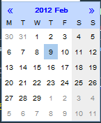
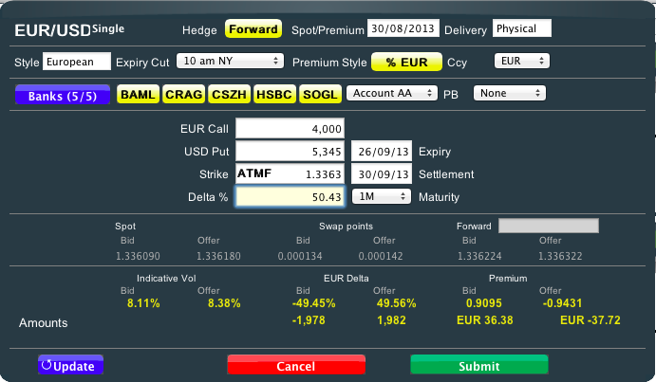
RFQ panel – Single leg strategy
Select broken Expiry date using Calendar or select fixed Maturity.
Key in Base or Term currency amount.
Key in Strike Price or type ‘s’, ‘S’, ‘f’ or ‘F’ for ‘At The Money’ Spot or Forward respectively.
(Applies to Call, Put, Straddle and Spread strategies)
Forward Hedge pre-defined rate, when Forward Hedge is selected
Key in Delta as a percent.
Click to cancel trade before submitting RFQ.
Click to Submit RFQ to selected banks.
7

Slide 8
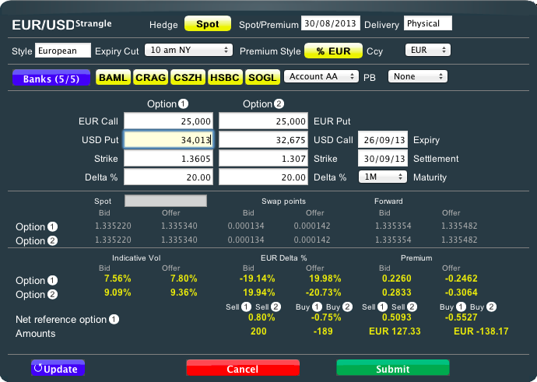
RFQ panel – Strangle strategy
Key in Leg 1 (Call) Base or Term currency amount.
Leg 2 (Put) notional amount can be different from Leg 1 (Call).
Key in Leg 1 (Call) Delta, which automatically sets Leg 2 (Put) Delta.
Key in Leg 2 (Put) Delta, if different from Leg 1 (Call) Delta.
FX Rates
(For each leg)
8

Slide 9

RFQ panel – Straddle strategy
Key in Leg 1 (Call) Base or Term currency amount.
Leg 2 (Put) notional figures will always match Leg 1.
Key in Leg 1 (Call) Strike.
Alternatively type ‘DN’, ‘0d’, ‘0D’, ‘N’, ‘n’, ‘DNS’ for delta neutral, ATM Spot or ATM Forward
Key in Leg 2 (Put) Strike will always match Leg 1 (Call).
Delta % field is not editable.
9

Slide 10
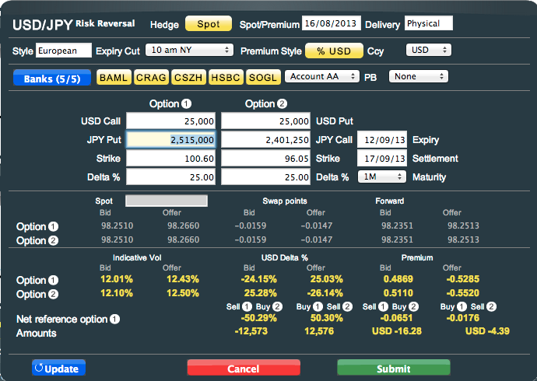
RFQ panel – Risk Reversal strategy
Key in Leg 1 (Call) Base or Term currency amount.
Leg 2 (Put) notional amount can be different from Leg 1 (Call).
Key in Leg 1 (Call) Delta, which automatically sets Leg 2 (Put) Delta.
Key in Leg 2 (Put) Delta, if different from Leg 1 (Call) Delta.
10

Slide 11
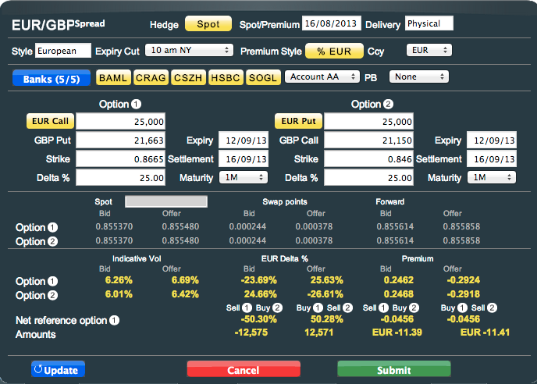
RFQ panel – Spread strategy
Generic 2 Leg / Calendar Spreads
Select Call or Put (For Each Leg).
Key in Base or Term currency amount. Key in Strike Price or Delta as a percent. (For Each Leg)
11

Slide 12
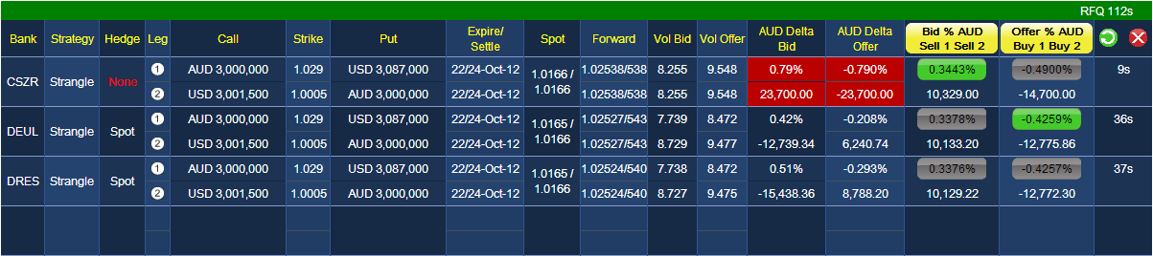
Quote response panel – with hedge
(Streaming quotes from up to 5 banks)
Select to show direction of trade in the Leg column
Expiry / Settlement are displayed by showing the day of month of expiry, together with the full date of the settlement
Select Premium Bid or Offer buttons to complete a trade.
Green buttons indicate Best Price for Bid and Offer.
RFQ lifetime in seconds.
Select to suspend RFQ and open up Trade Panel . User may then edit trade and re-submit.
Select to cancel RFQ.
Individual quote time-outs in seconds for each bank. Once timed out, new quote will automatically refresh if RFQ session has not expired.
Forward rates are displayed as the full rate for the bid and then the least significant figures for the offer
12

Slide 13
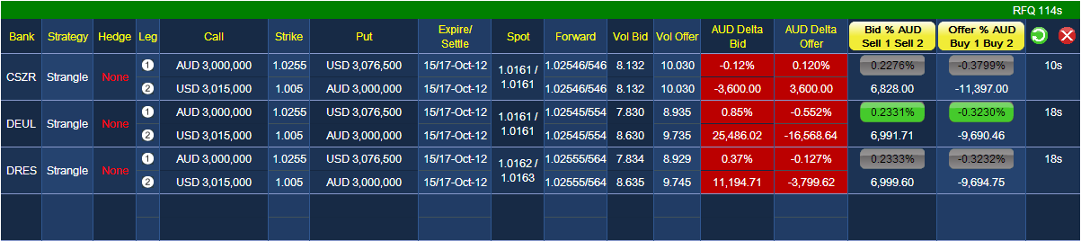
Quote response panel – without hedge
(Streaming quotes from up to 5 banks)
Select Premium Bid or Offer buttons to complete a trade.
Green buttons indicate Best Price for Bid and Offer.
If “None” is selected as Hedge type, the Delta bid-offer fields will appear in red to indicate trade is un-hedged.
RFQ lifetime in seconds.
Select to suspend RFQ and open up Trade Panel . User may then edit trade and re-submit.
Select to cancel RFQ.
Individual quote time-outs in seconds for each bank. Once timed out, new quote will automatically refresh if RFQ session has not expired.
Expiry / Settlement are displayed by showing the day of month of expiry, together with the full date of the settlement
Forward rates are displayed as the full rate for the bid and then the least significant figures for the offer
13

Slide 14
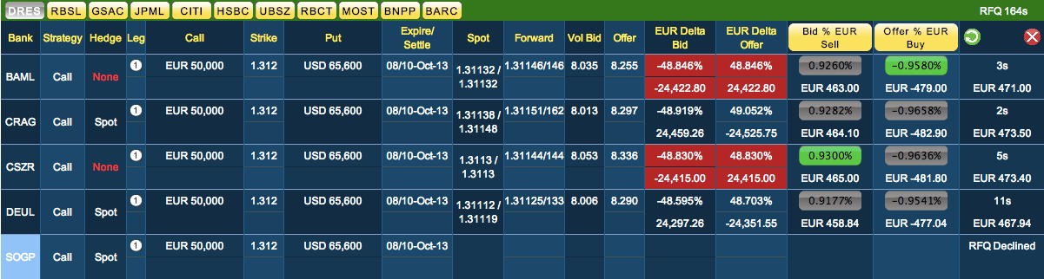
Quote Response panel – Provider substitution
As Digital Vega continues to add new Liquidity Providers to the platform, not all Banks support and price all structures or currency pairs and in this case users will typically see an “RFQ Declined” message. In order to address this, Digital Vega has developed a Provider Substitution capability:
Manual Substitution: where an RFQ is declined, user clicks on the declining providers name on the panel which brings up a list of other available providers. Clicking on one or more of these will include them in the RFQ
Automatic Substitution: Users can also elect to have declining providers replaced automatically; please call us to enable this facility.
14

Slide 15
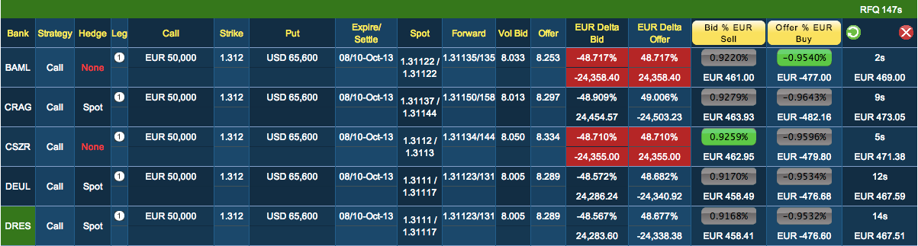
Quote Response panel – Manual provider substitution (MPS)
If a quote is declined or unsupported, choose a another provider
The provider is replaced with a new provider
15

Slide 16
Quote Response panel – Auto provider substitution (APS)
If a quote is declined or unsupported:
The declining Provider is automatically replaced with a new Bank
16

Slide 17
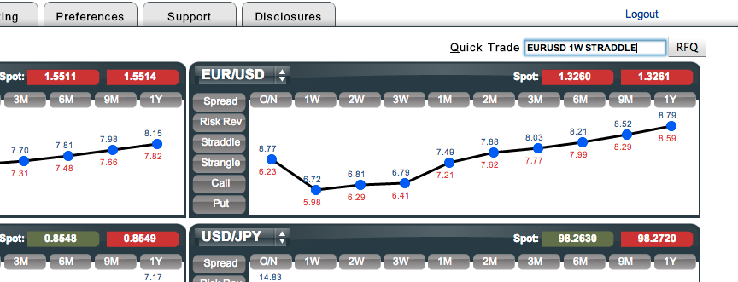
QuickPrice
User can enter currency pair, tenor and strategy then select the RFQ button to open the RFQ window
Supported inputs are:
Currency Pair can be entered as EURUSD, eurusd, EUR/USD or eur/usd on any of the supported currency pairs.
Tenors can entered as 1w or 1W on any supported tenor.
Strategies can be entered in upper or lower case as follows, call, put, straddle, strangle, riskrev and spread
Click ‘Q’ to focus on the Quick Trade window

Slide 18
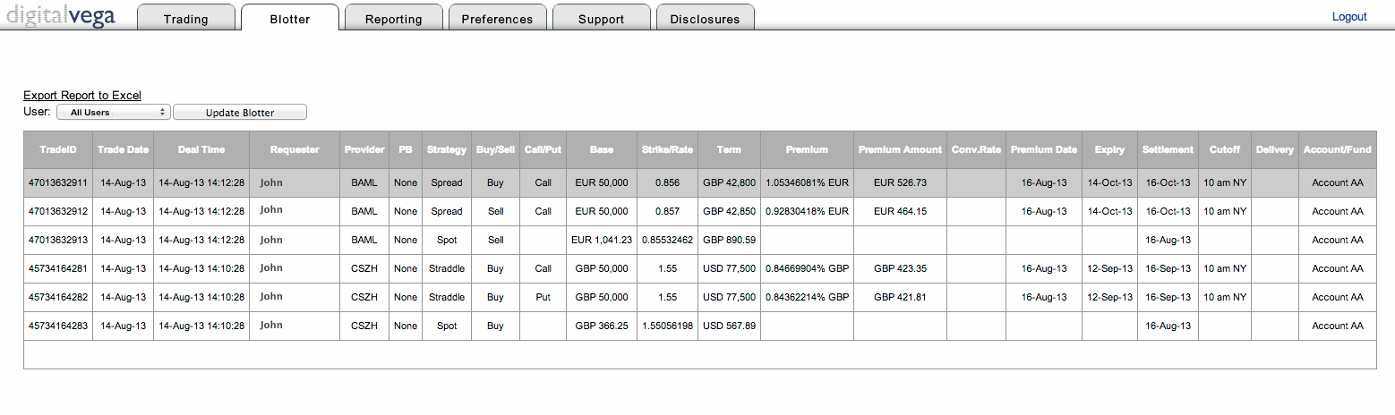
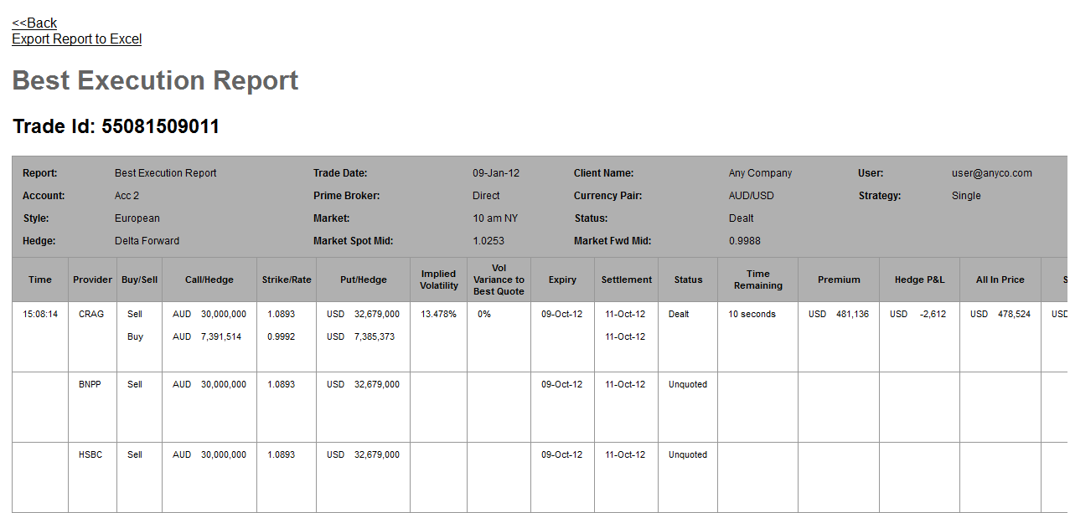
Blotter
Select Export Report to Excel to save blotter data.
Click to refresh blotter.
Blotter contains completed trades.
View trades of‘ All Users’ or only the user who is logged in.
Click a trade to display Best Execution Report.
Trade done at this price.
Report displays non-winning quotes for RFQ.
18

Slide 19
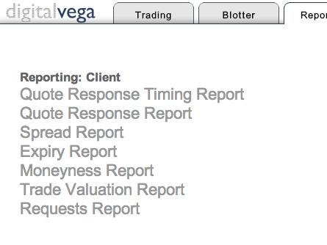
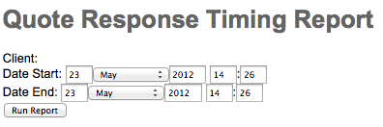
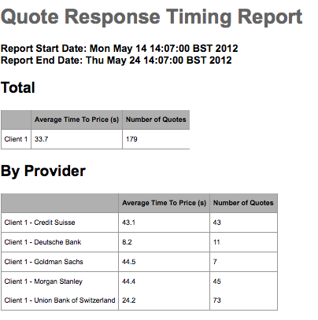
Reports – Quote response timing report
1
On Reporting tab, select Quote Response Timing Report.
2
Enter report start and end Date or default to today’s date and Run Report.
3
View Report details which lists RFQ response timing details by Provider, and by the average time to price and number of quotes.

Slide 20
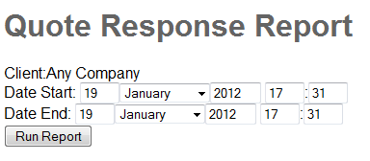
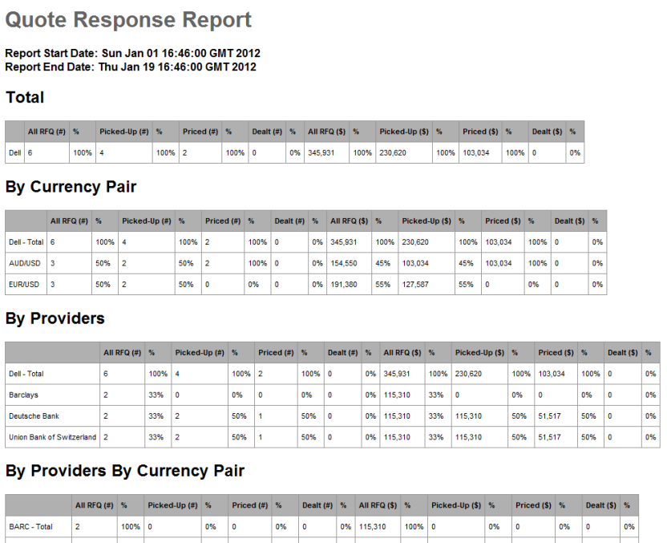
Reports – Quote response report
1
On Reporting tab, select Quote Response Report.
2
Enter report start and end Date or default to today’s date and Run Report.
3
View Report details which lists RFQ response details by currency pair, Provider, and by Provider and currency pair.
20

Slide 21
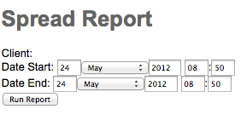
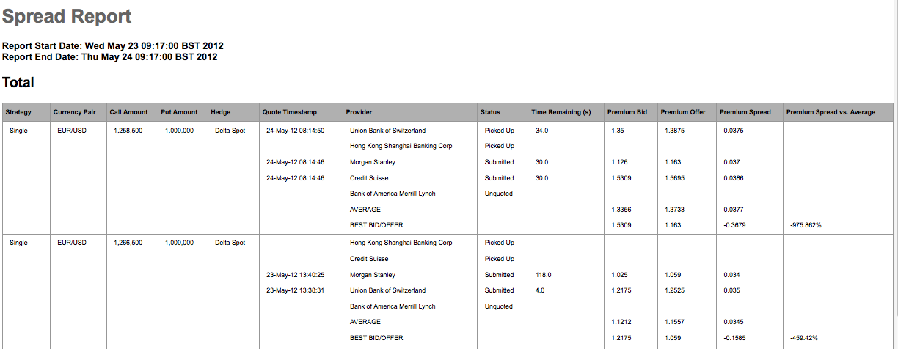
Reports – Spread report
1
On Reporting tab, select Spread Report.
2
Enter report start and end Date or default to today’s date and Run Report.
3
View Report details which lists RFQ response from providers by premium spread.

Slide 22
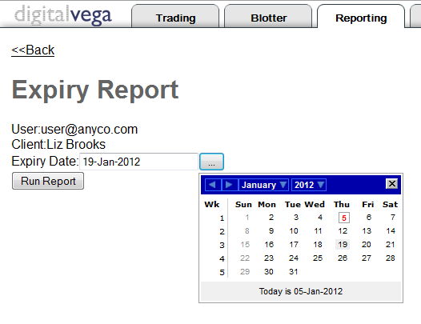
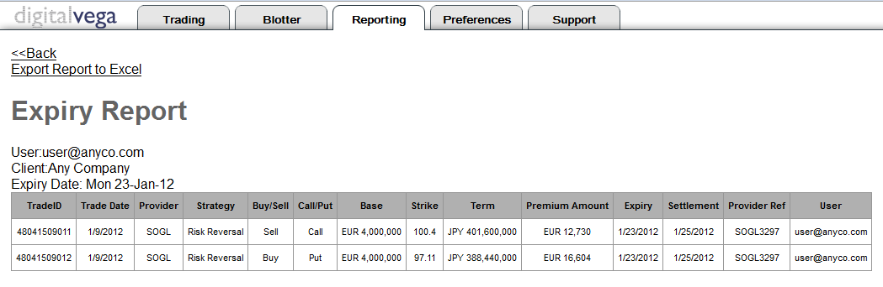
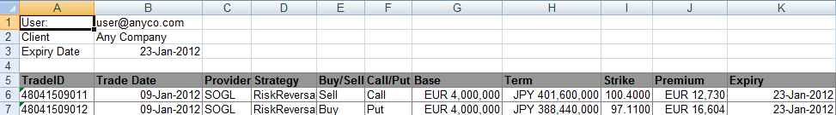
Reports – Expiry report
1
On Reporting tab, select Expiry Report.
2
Enter Expiry Date or use Calendar to select date.
3
View Report details. Select “Export Report to Excel” to save report data.
22

Slide 23
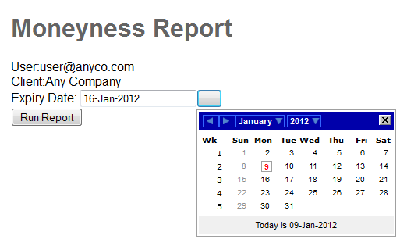
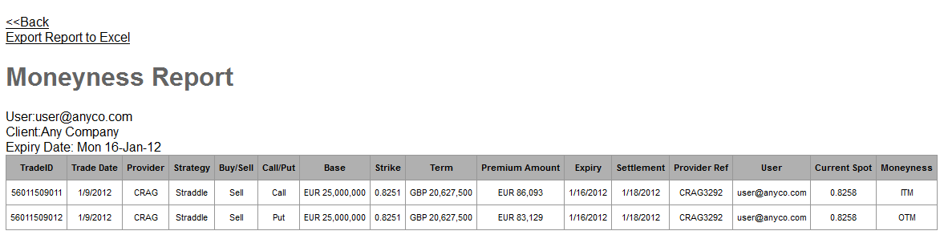
Reports – Moneyness report
1
On Reporting tab, select Moneyness Report.
2
Enter Expiry Date or use Calendar to select date.
Moneyness:
ITM = in the money
OTM = out of the money
3
View Report details. Select “Export Report to Excel” to save report data.
23

Slide 24
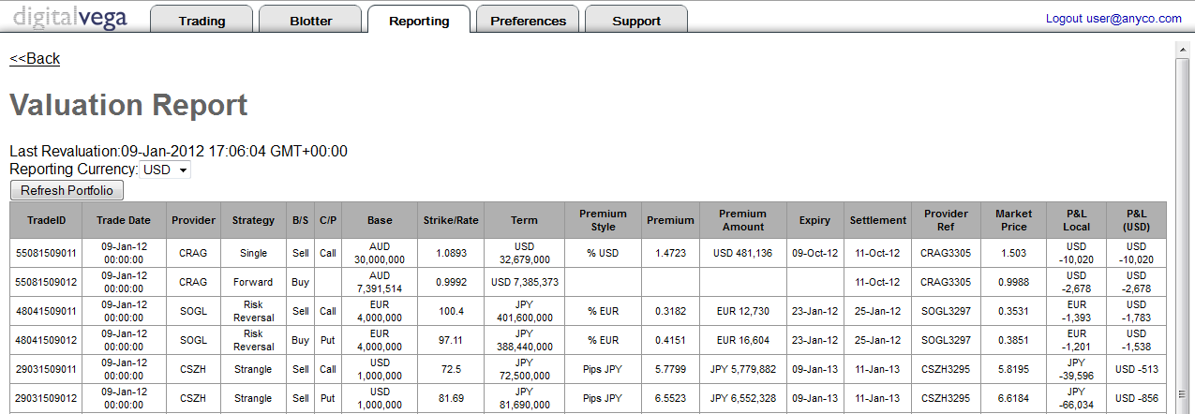
Reports – Trade valuation report
1
On Reporting tab, select Trade Valuation Report.
2
View Report details.
Profit and Loss in Local currency and USD
24

Slide 25
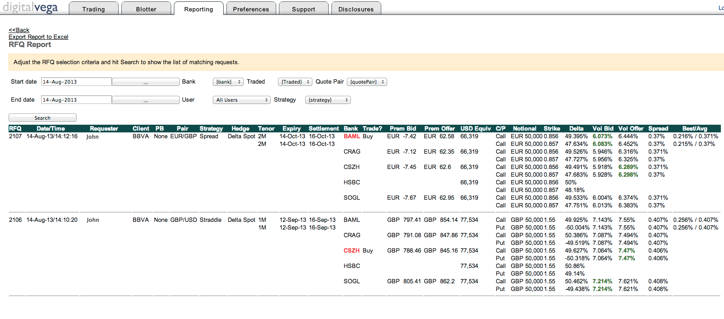
Reports – Requests report
Filter Results by Bank, User, Traded, Currency Pair or Strategy
1
On Reporting tab, select Requests Report.
2
Enter Start and End Dates or use Calendar to select dates.
2
Click Search to view RFQs.
25

Slide 26
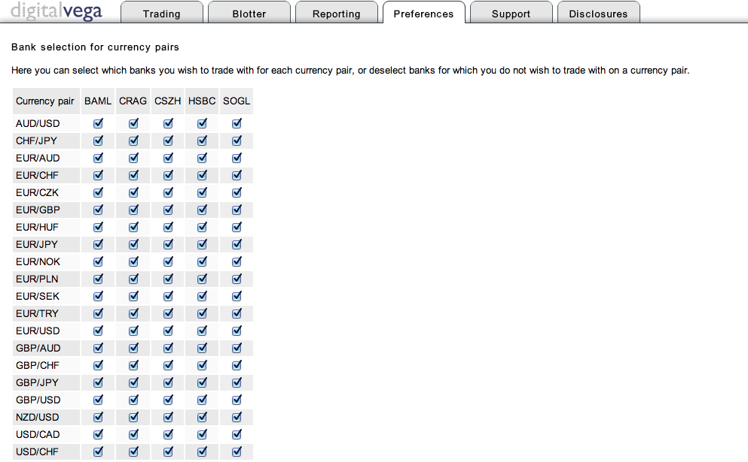
Preferences
Select the banks to trade with for each currency pair.
26

Slide 27
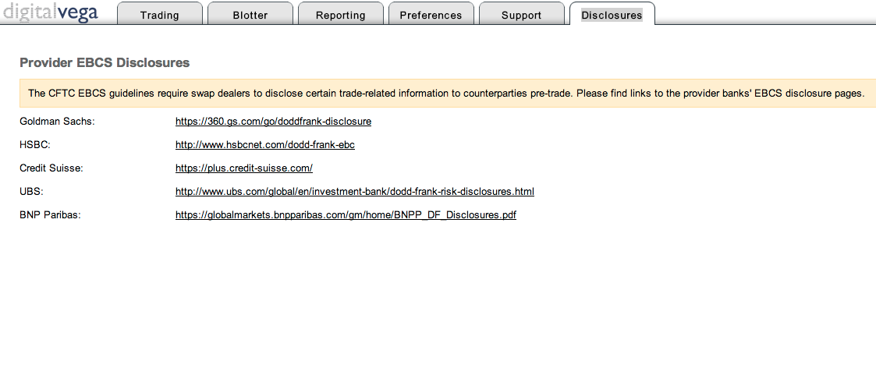
Disclosures
Provider Disclosure Links.
27

Slide 28
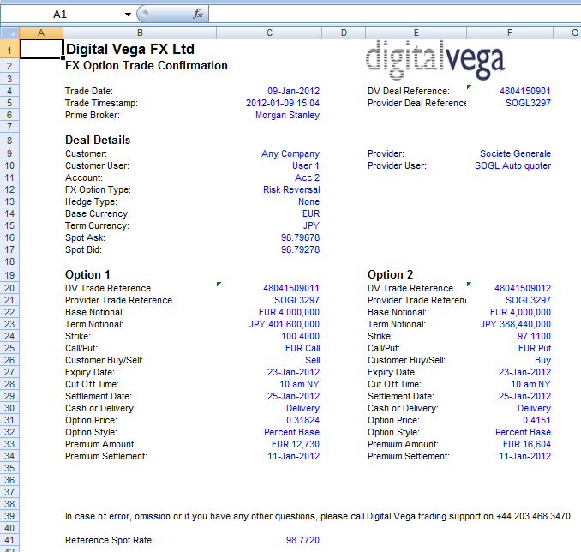
Trade confirmations
Trade Confirmations are emailed in an Excel format to designated email account(s).
28

Slide 29
Digital Vega trading hours
OPEN CLOSE LOCATION OFFSET
00:00 22:00 LONDON
01:00 23:00 ZURICH GMT +1
19:00 17:00 NEW YORK GMT -5
08:00 06:00 SINGAPORE GMT +8
08:00 06:00 HONG KONG GMT +8
09:00 07:00 TOKYO GMT +9
10:00 08:00 SYDNEY GMT +10

Slide 30
Contact
Digital Vega Support Team
Monday to Friday from 00:00 – 22:00 London
Trading Application Support Team:
email: support@digitalvega.com
Tel: +44 203 468 3470 or
+44 203 468 3471
Sales Team:
email: sales@digitalvega.com
Tel: +44 203 468 3472

